Slide 1


FOREST TYPE CLASSIFIERS

Slide 2
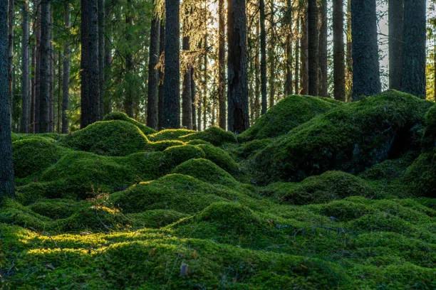
PROBLEM STATEMENT
Given a dataset containing various geographical and environmental features of Forested areas in the United States, the ultimate goal of this project is to analyze the data completely, with its features being engineered through certain techniques, one of them including the dimensionality reduction using the Principal Component Analysis, for the preprocessing step, and finally designing and/or implementing a good Machine Learning/Deep Learning algorithm for us to be able to correctly determine the forest cover type provided the finalized dataset, the description of which has been provided thoroughly in the subsequent section below.

Slide 3
TIMELINE
21-31 OCT 2023
11-20 OCT 2023
01-10 OCT 2023
SEP 2023
Data Analysis
Hypothesis tests
Data Preprocessing
EDA
01-10 NOV 2023
11-20 NOV 2023
21-25 NOV 2023
Data Re-analysis
Apply ML Model/Classifier
Model Evaluation

Slide 4
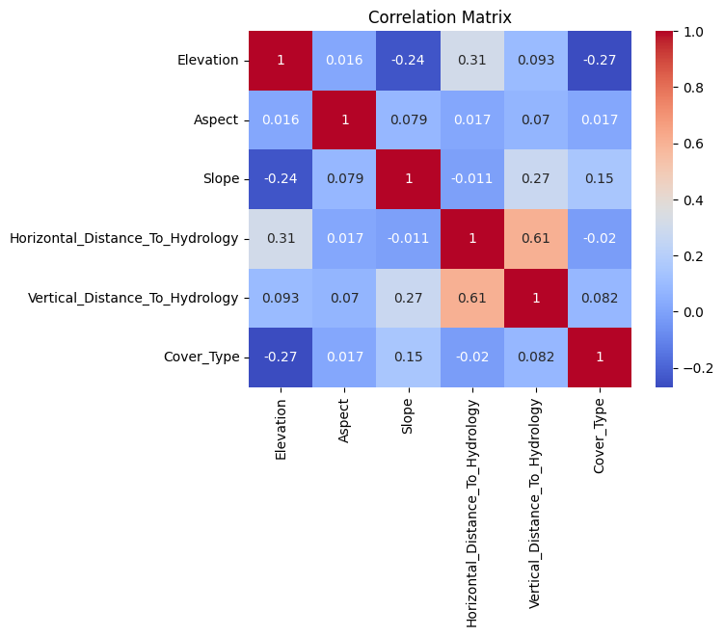
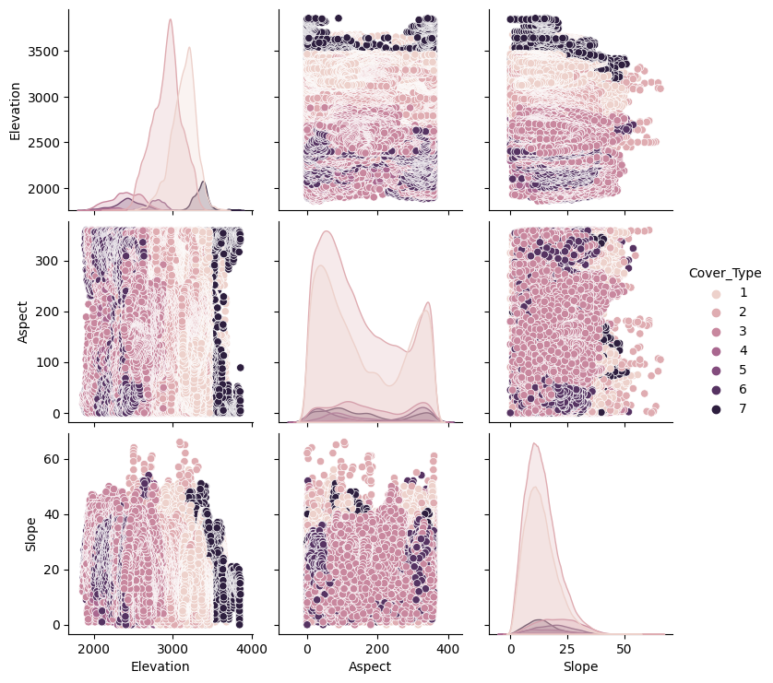
DATASET VISUALIZATION & DISTRIBUTION

Slide 5
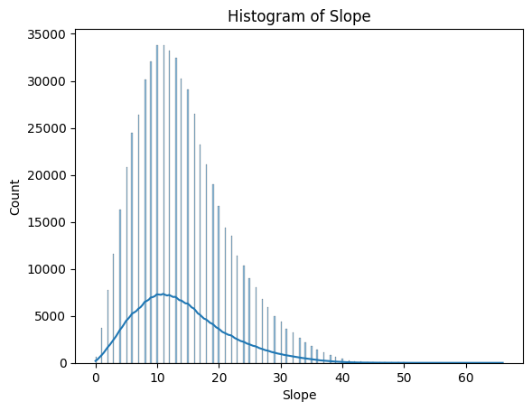
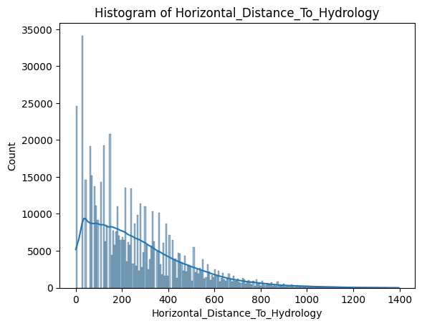
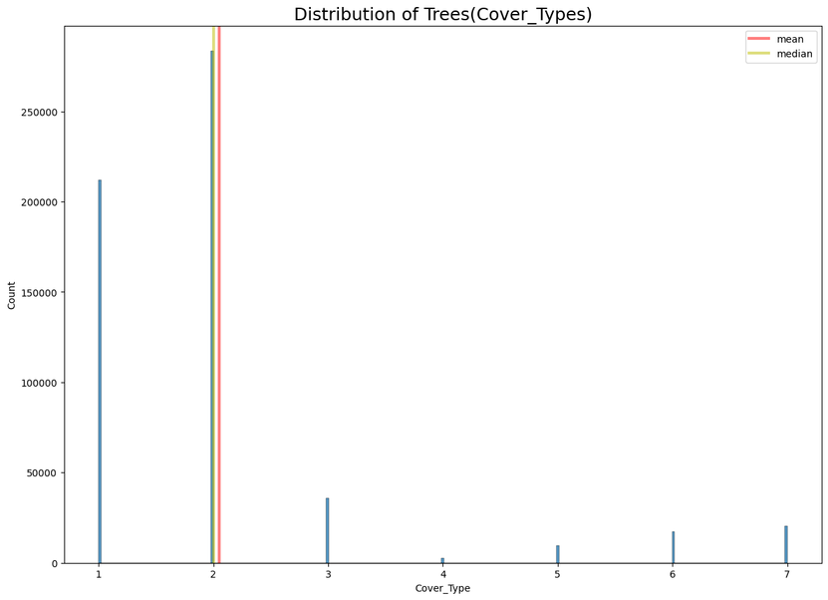
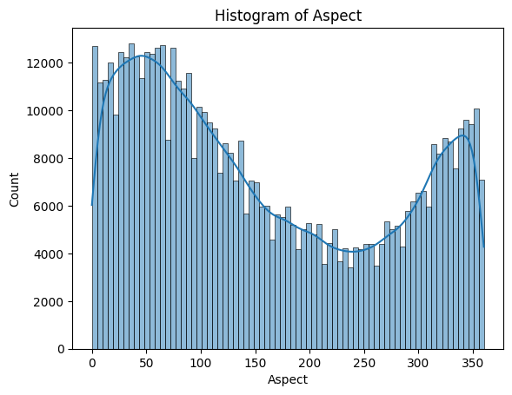
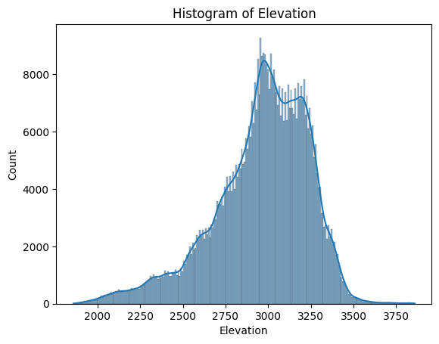
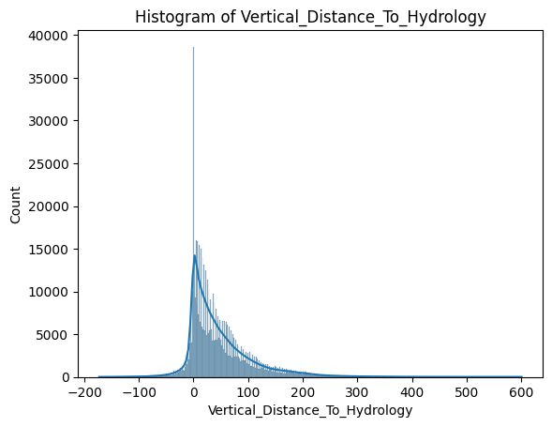

Slide 6
WHY PREPROCESSING IS NEEDED/ CHALLENGES
Missing data
Outliers
Data Scaling
Categorical Data
Data Skewness
Dimensionality
Class Imbalance
Data Quality
Normalization & Encoding
Feature Engineering

Slide 7
METHODOLOGY

Slide 8
MAIN POINTS
The essential steps in this project:
Perform Data Pre-processing.
Conduct appropriate Hypothesis tests with validation experiments.
Analyze the importance of certain attributes.
Apply a machine learning classifier model.

Slide 9
PREPROCESSING STEPS
Data Pre-processing includes:
a. Addition of appropriate column names to the data
b. Data Cleaning (removal of null, nan values etc)
c. Handling Outliers

Slide 10
HYPOTHESIS TESTING
Tests Used (sample size=100):
1. t-Test
2. Chi-Squared Test

Slide 11
THE T-TEST
Validation Experiments Used:
Conduct the same hypothesis test on large number of samples (10000).
Validate through actual calculation of mean for samples of a particular attribute.

Slide 12
THE CHI-SQUARED-TEST
Validation Experiments Used:
Conduct the same hypothesis test on large number of samples (10000).
Validate through actual calculation of Correlation between the selected attribute and the Cover_Type attribute.

Slide 13
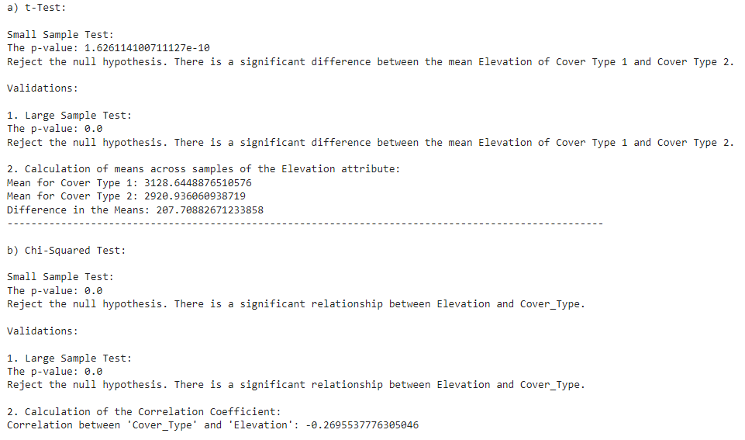

Slide 14
DATA RE-ANALYSIS
Conduct the same hypothesis tests for further attributes.
Determine for which attributes the null hypothesis is rejected, i.e, determine which attributes are imprtant for covertype prediction.

Slide 15
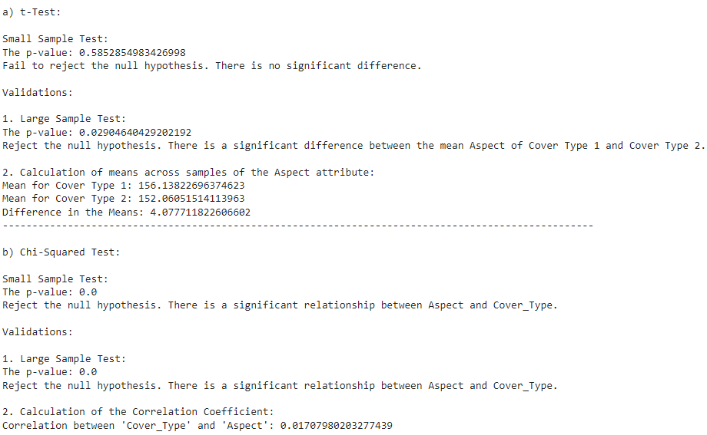

Slide 16
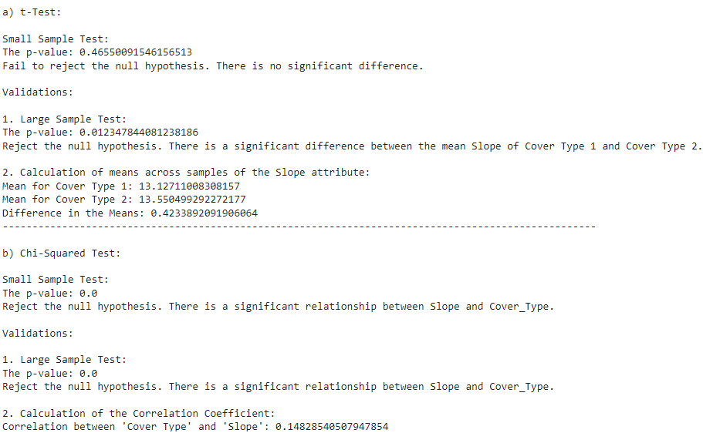

Slide 17
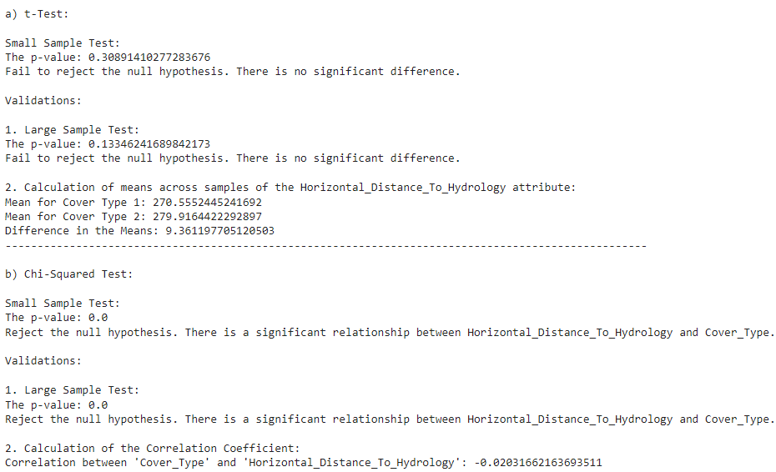

Slide 18
CONCLUSIONS FROM TESTS
1. Almost all of the attributes are relevant in determination of the cover type label.
2. Two to three attributes showed contradicting results (different for both t-tests and chi-squared tests), suggesting a possible lack of evidence, or insufficient data.

Slide 19
ML CLASSIFIERS

Slide 20
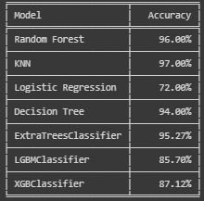
CLASSIFIERS

Slide 21
RESULTS

Slide 22
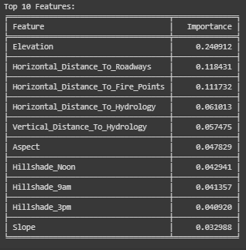
IMPORTANT FEATURES

Slide 23
CONCLUSION
Data Preprocessing:
one-hot encoding, outliers, select imp features
Models Implemented:
Random Forest, KNN, Logistic regression, Decision Tree, Extra Trees, LGBM, and XGBoost.
Model Performance:
KNN (accuracy 97%), Random Forest(96%)
Feature Importance:
Elevation and Horizontal distance to roadways and fire points

Slide 24
CONCLUSION
Insights for Conservation:
Understanding influential features aids conservation
Provides insights into factors affecting different forest cover types.
Areas for Improvement:
faster training model for such a large dataset
explore feature engineering and ensemble methods.

